Slide 1
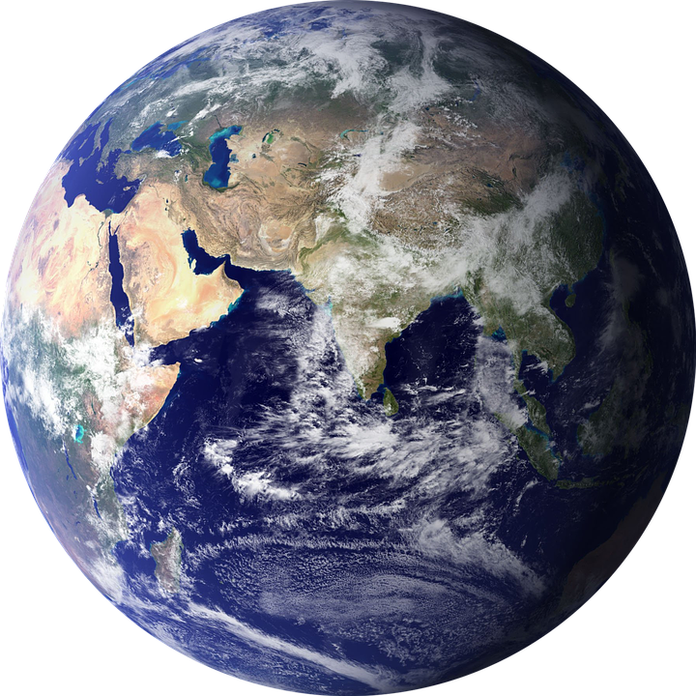
CULTURAL UNIVERSALS
A way to compare cultures across time and around the world

Slide 2
10 Cultural Universals 1-5
Theme: which indicate what is valued in a society, what the peoples’ code of ethics is, what symbols represent their ideas (e.g., Statue of Liberty in the U.S.A.).
Political Organization: which covers a society’s government, law enforcement and its war and peace strategies/tendencies.
Communications:which cover the language and number system of the people.
Food, Clothing and Shelter: which incorporate the types of food, clothing and
adornment and home/shelter styles.
Attitude toward the Unknown:which includes the peoples’ religious beliefs and practices and their death rituals.

Slide 3
10 Cultural Universals 6-10
Background:which involves a time during which the culture existed, a geographic setting and a group of people for whom one can provide a physical description.
Arts and Esthetic Values:which are seen in its art, music, dance, drama and literature.
Recreation: which is enjoyed by all peoples as seen through their games and sports and their use of leisure time.
Economics:A culture’s technology, transportation, mode of trade and/or money and its division of labor are considered items in the category of “economics.”
Family and Kin: includes the culture’s child training, rites of passage, education, marriage traditions and family grouping styles.
U.S.A.).

Slide 4
For this DIG project, we are starting by focusing on 2
THEME-which indicate what is valued in a society, what the peoples’ code of ethics is, what symbols represent their ideas (e.g., Statue of Liberty in the U.S.A.).
BACKGROUND-which involves a time during which the culture existed, a geographic setting and a group of people for whom one can provide a physical description.

Slide 5
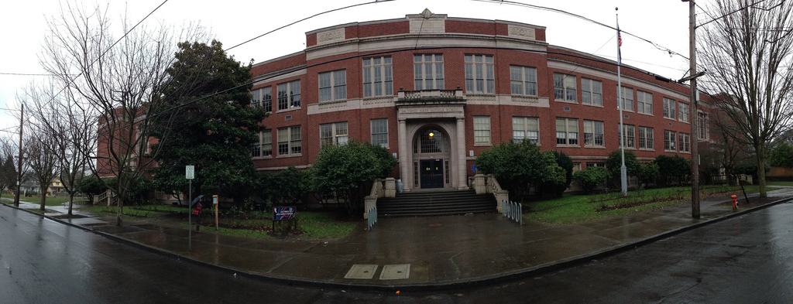
Let’s Practice with da Vinci Middle School
Theme- Name some important symbols? What’s important to our school? What is right and wrong? How do we know?
Background-What time period do we exist? What kind of geography surrounds da Vinci?

Slide 6
Results?
Theme-
Background-

Slide 7
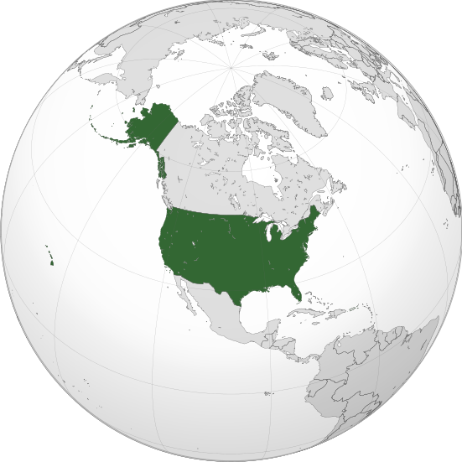
What about the USA?
Theme- Name some important symbols? What’s important to our country? What is right and wrong? How do we know?
Background-What time period do we exist? What kind of geography exists in the U.S.A.?

Slide 8
Results?
Theme-
Background-

Slide 9
Now you get to create your own culture
Brainstorm ideas for an original culture, using these categories as a guide. Once you have your ideas for a unique culture, describe the following five aspects of your culture on a separate piece of paper using complete sentences. See the additional guidelines in your DIG Overview packet. Remember, your culture should be completely original.
Time Period (when did these people live)
Geographic Setting (where is it exactly or what kind of geographic setting - forest, desert, etc.)
Physical Description of People (what do the people look like)
Values (what is important to them)
Ethics (what is right and wrong)

