Slide 1
PLEASE SIT AT WORK TABLE MARKED WITH YOUR SOCIAL CLASS.

Slide 2
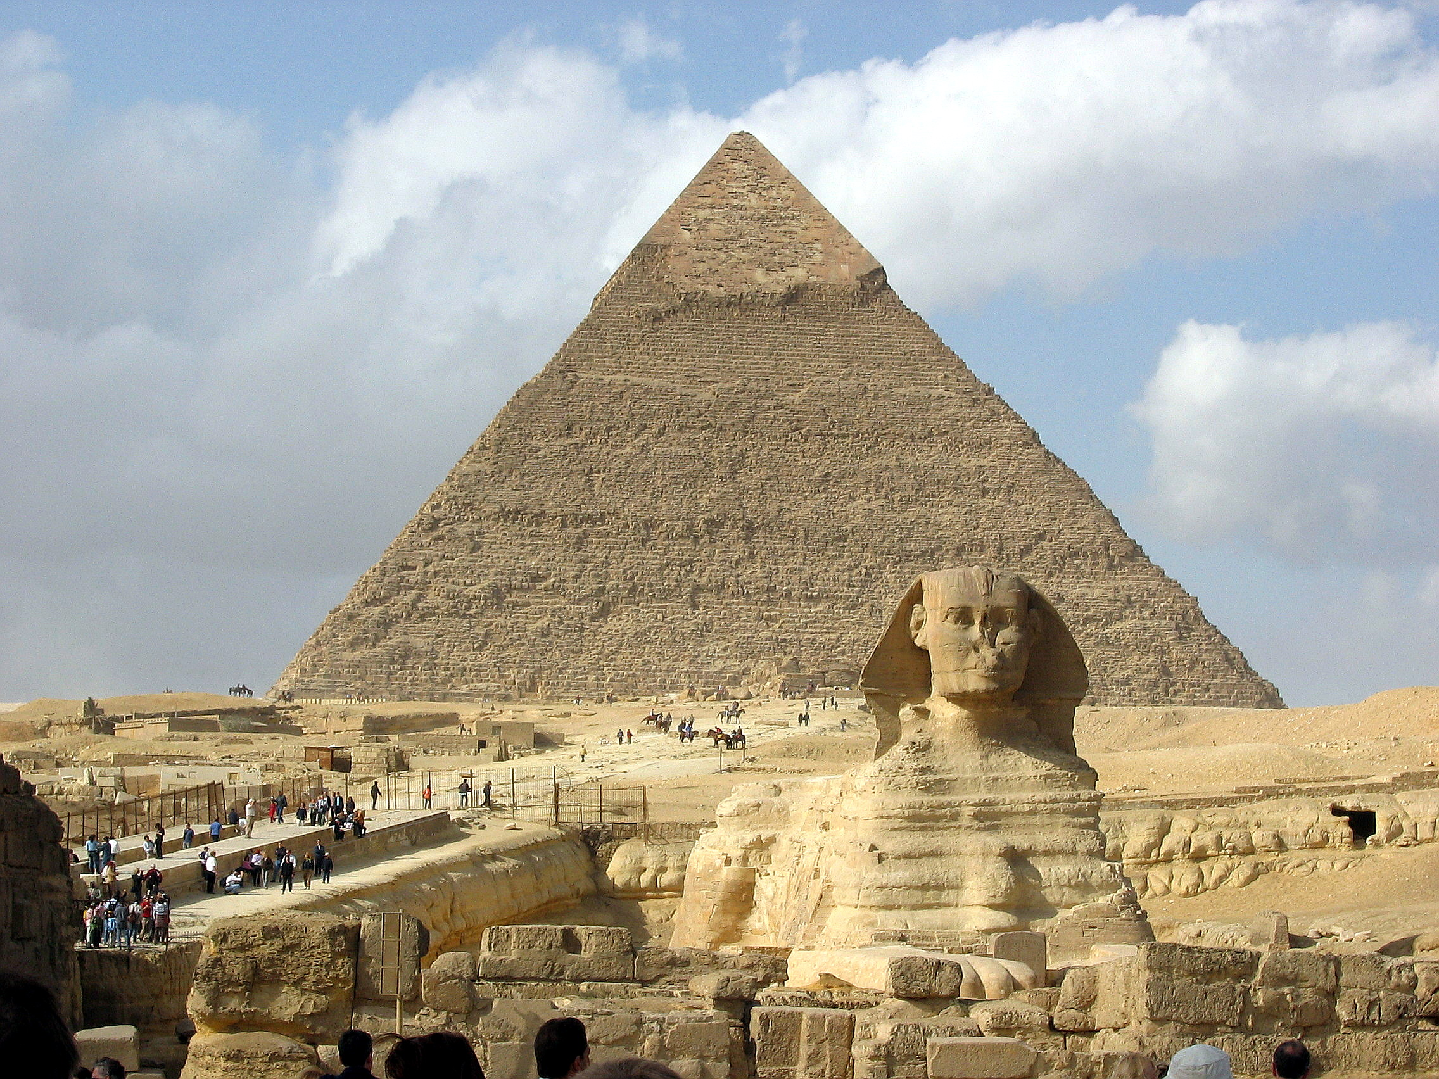
EGYPT ACTING ACTIVITY

Slide 3
BIG PICTURE
SIT WITH SOCIAL CLASS FROM FRIDAY. THIS IS WHERE YOU WILL BE SITTING FOR CREATION OF SCENE
WE ARE WORKING TO CREATING A 5 MINUTE SCENE THAT DEMONSTRATES WHAT “A DAY IN THE LIFE” OF THAT CLASS LOOKS LIKE
EXAMINE 3 FORMS USED IN THIS ACTIVITY. 1) NOTE TAKING GRAPHIC ORGANIZER FOR ENTIRE SECTION 2) STUDENT HANDOUT AND 3) ACTING SIMULATION HANDOUT
BEGIN ASSIGNING ROLES FOR TEAMS
READ CONTENT, TAKE NOTES AND CREATE SCENE
ACT AND LEARN TOGETHER

Slide 4
PLAN FOR THE DAY
WE ARE FOCUSING ON SECTIONS 2 AND 3 TODAY (CROSS OUT SECTION 1)
TWO CRITICAL LEADERSHIP ROLES WILL BE CHOSEN FOR EACH SOCIAL CLASS- HISTORIAN AND DIRECTOR.
HISTORIAN LEADS READING
DIRECTOR LEADS SCENE CREATION

Slide 5
HISTORIAN
HISTORIAN: LEADS GROUP READING (popcorn) AND EXAMINATION OF QUESTIONS IN STUDENT HANDOUT (Look at example on board)
-STOP GROUP WHEN ANSWERS COME UP IN READING, SO GROUP CAN FILL OUT GRAPHIC ORGANIZER.
-MAKES SURE ALL QUESTIONS ARE ANSWERED AT END OF READING
-PLEASE LET MR. GERSHUNY KNOW WHEN YOUT TEAM IS DONE WITH THE NOTE TAKING AND READING

Slide 6
DIRECTOR
DIRECTOR: LEADS GROUP THROUGH READING OF ALL REQUIRED COMPONENTS OF SCENE (STEP 3)
DIRECTOR MAKES SURE ALL REQUIRED ASPECTS ARE INCLUDED IN SCENE
DIRECTOR WRITES DOWN OVERVIEW OF SCENE

Slide 7
CHOOSE THESE 2 ROLES
I WILL GIVE YOU 4 MINUTES TO CHOOSE THESE 2 ROLES IN YOUR GROUP
EVERY STUDENT WILL HAVE A ROLE, EVERY STUDENT WILL ACT, AND EVERY STUDENT WILL BE ABLE TO HELP CREATE THIS SCENE AND PROPS OR COSTUMES
THESE JOBS ARE ESSENTIAL, SO EVERY TEAM NEEDS THESE ROLES FILLED

Slide 8
4 MINUTES TO CHOOSE
Aaaaaaaand GO!!

Slide 9
HISTORIAN LED READ ALONG
HISTORIANS WILL START BY LEADING GROUP IN READING OF THEIR GUIDING QUESTIONS (STEP 2 ON WORKSHEET)
KEEP OVERALL VOICES DOWN. AT LEAST 5 PEOPLE READING AT SAME TIME, SO IF OTHERS ARE CHATTING IT WILL BE REALLY HARD TO HEAR
ALL GROUP MEMBERS SHOULD HAVE BOOK OPEN TO THEIR SOCIAL CLASS, AND THE WORKBOOK OPEN TO PAGE 66 (EVERYONE TAKES NOTES)
HISTORIANS SHOULD ALLOW FOR MANY STUDENTS TO READ, NOT JUST HISTORIAN
AS ANSWERS TO QUESTIONS IN STEP 2 COME UP, HISTORIANS SHOULD HALT READING SO GROUP CAN ANSWER THE QUESTIONS ON PAGE 66

Slide 10
TRANSITION TO SCENE CREATION

Slide 11
DIRECTOR LED DISCUSSION OF REQUIRED ASPECTS
DIRECTORS TAKE READING AND RECORDING LEAD
DIRECTORS SHOULD FIRST LEAD TEAM IN READING/DISCUSSION ON STEP 3 ON YOUR HANDOUT
ONCE DONE, DIRECTORS LEAD THE TEAM THROUGH THE BRAINSTORM AND DEVELOPMENT OF THE SCENE

Slide 12
LET’S SEE WHAT OTHER ROLES ARE OUT THERE

Slide 13
SPECIAL EFFECT DESIGNER #1
You are in charge of bringing props in for the group.
Write down what special effect items are you bringing or creating for the performance? How are they being used?

Slide 14
SPECIAL EFFECT DESIGNER #2
You are in charge of bringing props in for the group.
Write down what special effect items are you bringing or creating for the performance? How are they being used?

Slide 15
HOST #1
You are the rehearsal director.
Have you been able to rehearse your performance at least 3 times? Write down what went well in the performances, what does your group need to work out?

Slide 16
HOST 2
You care in charge of the volunteers from the audience.
Write down when are you planning on bringing the volunteers from the audience up? What are you planning on telling them?

Slide 17
Playwright....For groups of 7 only
Your job will be to write down the action and lines included in the scene. Include Setting, Prop and Costume List, Actor overview and lines.

