Slide 1
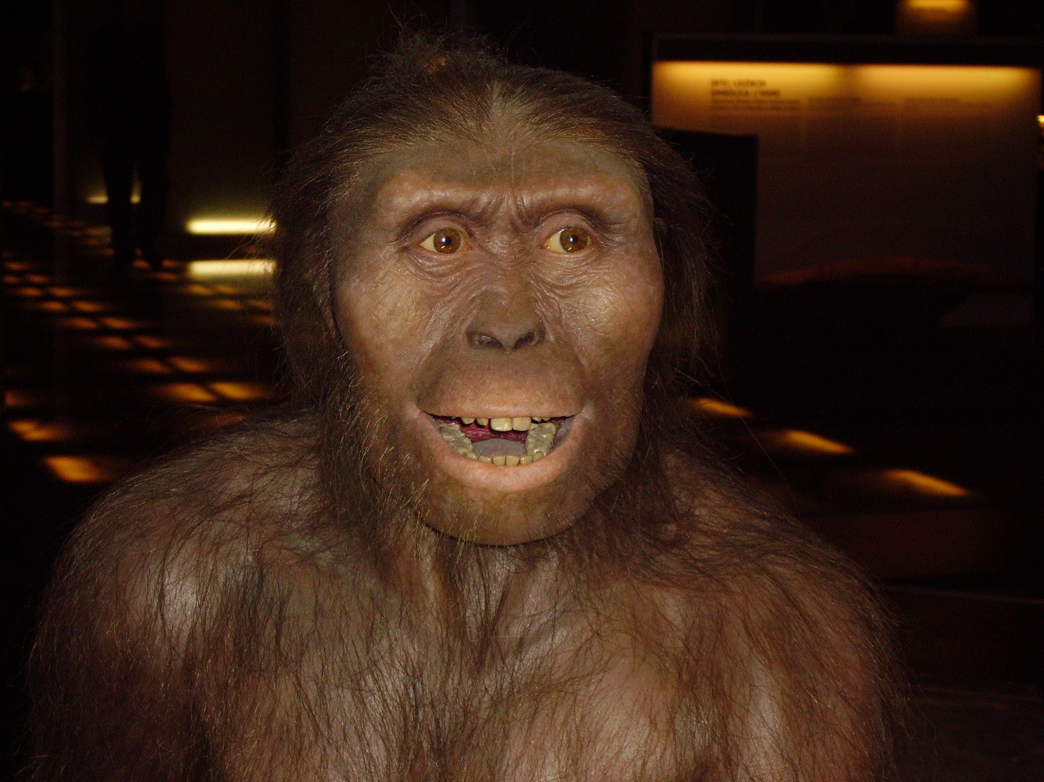
HOMINID
JIGSAW
Piecing together 4 million years of history

Slide 2
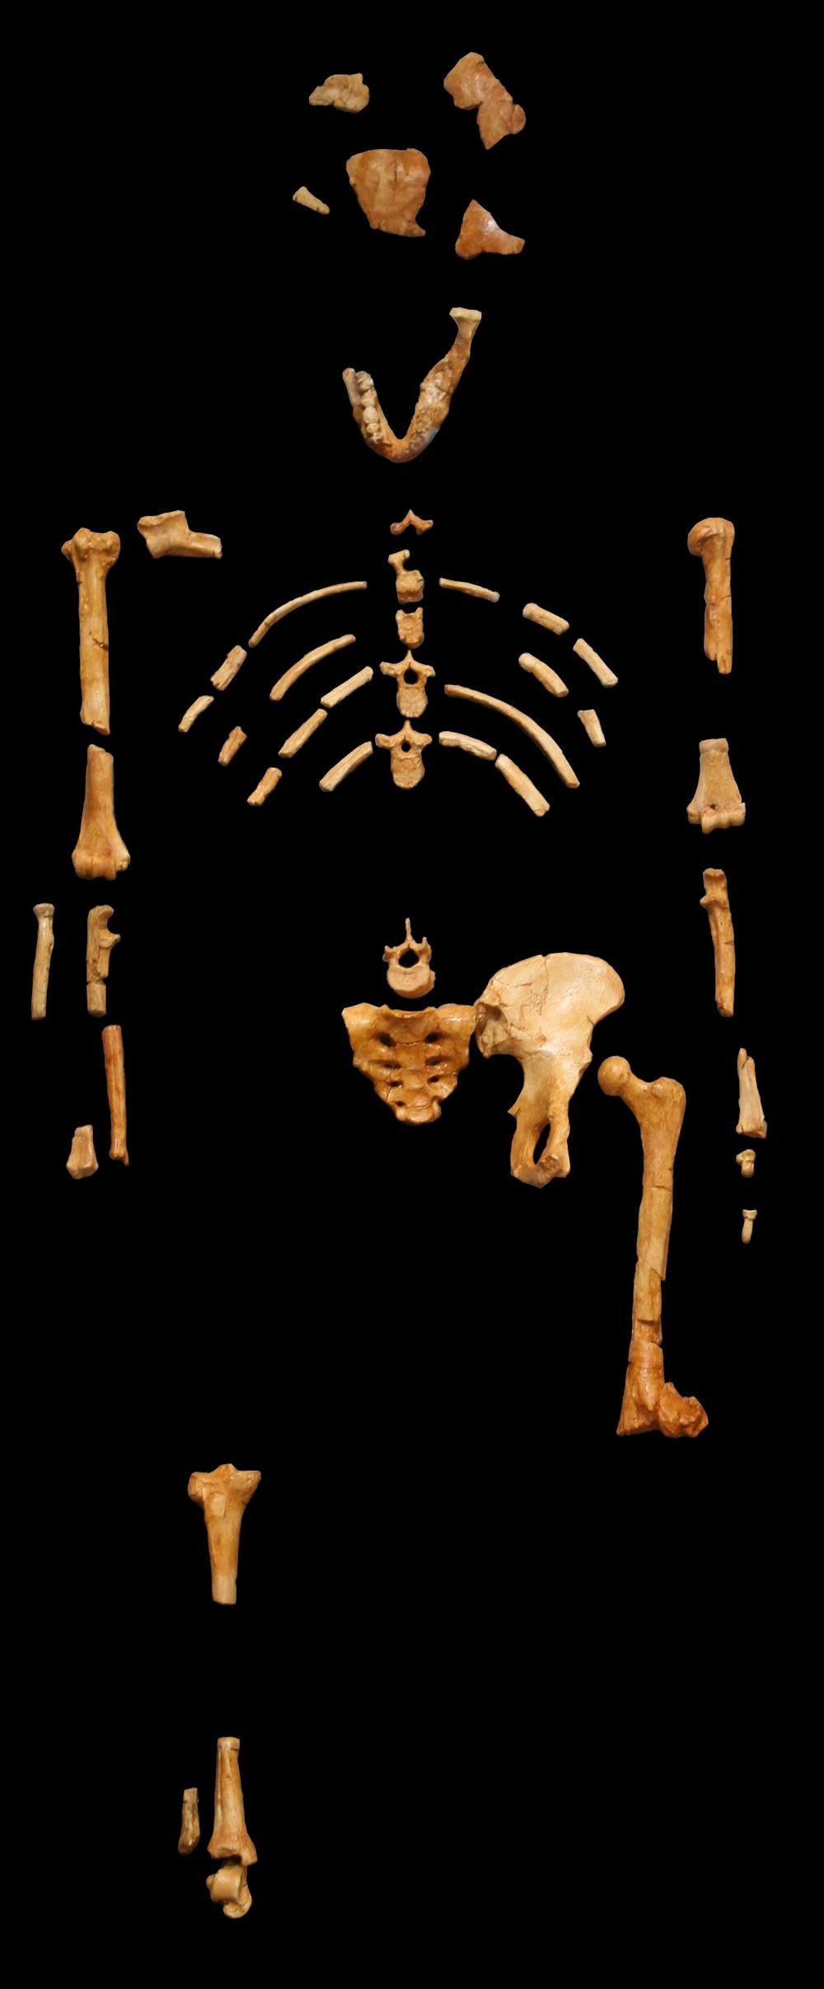
DIRECTIONS:
For this assignment you will be broken down into groups of 4
Your group will be assigned a specific hominid from Chapter 2, and your group will become the expert
You will create a poster, and a presentation to teach the class about your hominid

Slide 3
Picking groups of 4
I will randomly choose names out of the box.
Groups will not be able to choose their hominid. Your team will randomly choose a number between 1-5, with a few repeats, and get one assigned to you,
Once you have your team, and hominid, you will read your section together and focus on the following questions

Slide 4
In Your Small Group
You are going to read your assigned chapter as a group, and answer the corresponding workbook page (14-18)
Do not answer any other pages for the other hominids
You will then create a poster and presentation for the class to teach them about your hominid

Slide 5
Once you are the expert of your Hominid
You are going to create a poster that celebrates and explains your hominid.
Page 19 of your workbook, there is a rough draft sheet. each of you is going to create a mini poster of your hominid, that highlights the key attributes of your given hominid that you discovered as a group.
Once your group is done, one of you will get to create a final draft poster, while the rest of the group works on their presentations

Slide 6
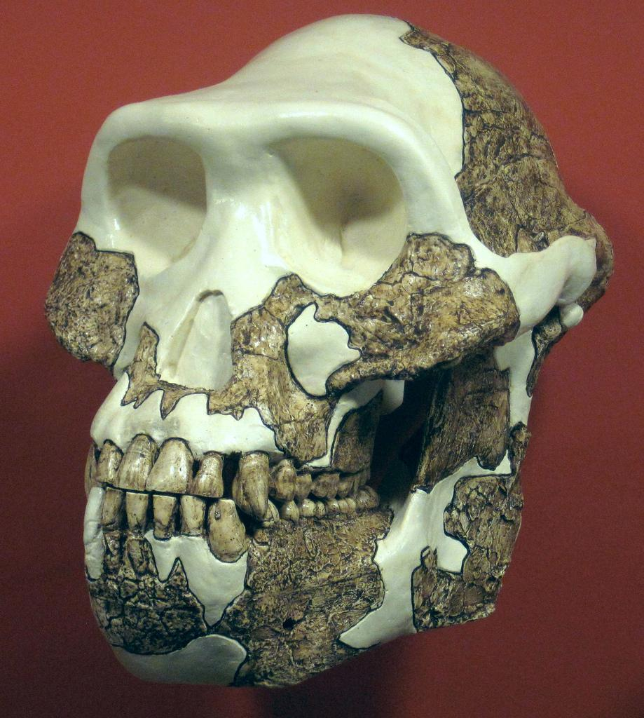
Hominid Questions to be Answered on your poster
When and where did your hominid live (Time period, location)?
What made them different or unique? What capabilities (skills or tools) did they have?
What was their lives like (Homes, Families)?
How did they get their food?
What important information should the class have about your hominid

