Slide 1
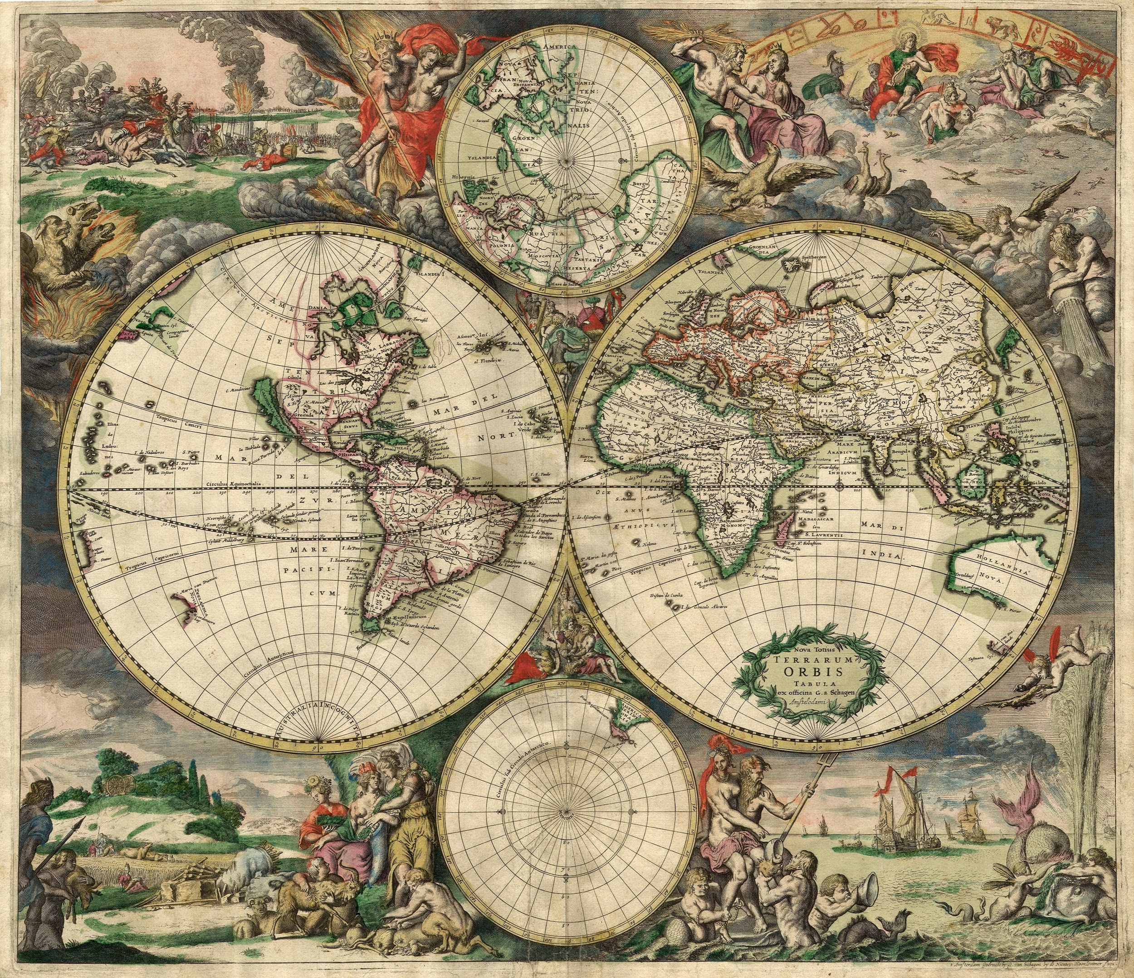
Journey Map
Art that represents our own paths

Slide 2
For this assignment you will...
Create an artistic representation of your past, present, and goals for the future.
Use these artistic pieces as a way to introduce ourselves to the class
Practice our public speaking expectations

Slide 3
Directions
Each “map” needs to have 8 components
2 that represent things from your past
2 that represent things from your present (your life now)
2 that represent things from your hopeful future (goals, plans, hopes)
2 that represent your interests or hobbies

Slide 4
We will share them with the class
So make sure you only include information you want to share with everyone
Some will be used to help decorate the classroom.

